Slide 1
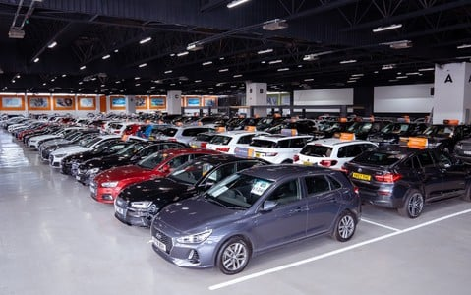
Used cars price prediction By machine learning
Capstone Project - 1
Presented By
Aman Singh

Slide 2
Contents:
Introduction
Work Flow in Machine Learning
Libraries
Get Data & Data Understanding
Data Cleaning
Exploratory Data Analysis
Data Pre-processing
5 Best Performing models
Scorecard
Conclusion
Deployment

Slide 3
Introduction
In India, millions of used vehicles are sold each year. Effective pricing strategies can help any company to efficiently sell its products in a competitive market and making profit. In the automotive sector, pricing analytics play an essential role for both companies and individuals to assess the market price of a vehicle before putting it on sale or buying it. The rise of used cars sales is exponentially increasing. Car sellers sometimes take advantage of this scenario by listing unrealistic prices owing to the demand.
Therefore, arises a need for a model that can assign a price for a vehicle by evaluating its features taking the prices of other cars into consideration. In this project, we use supervised learning methods to predict the prices of used cars.

Slide 4
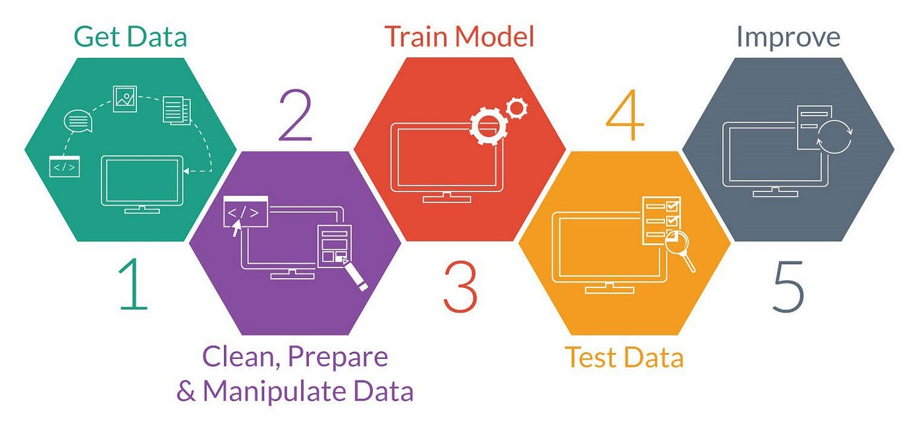
Work Flow In Machine Learning

Slide 5
Libraries
Numpy : Numpy is a library for the Python programming language, adding support for large, multi-dimensional arrays and matrices, along with a large collection of high-level mathematical functions to operate on these arrays.
Pandas : Pandas is an open source Python package that is most widely used for data science/data analysis and machine learning tasks. It is built on top of another package named Numpy, which provides support for multi-dimensional arrays.
Matplotlib : Matplotlib is one of the plotting library in python which is however widely in use for machine learning application with its numerical mathematics extension- Numpy to create static, animated and interactive visualizations.
Seaborn : Seaborn is a library for making statistical graphics in Python. It builds on top of matplotlib and integrates closely with pandas data structures. Seaborn helps you explore and understand your data.
Sklearn : Scikit-learn (Sklearn) is the most useful and robust library for machine learning in Python. It provides a selection of efficient tools for machine learning and statistical modeling including classification, regression, clustering and dimensionality reduction via a consistence interface in Python.

Slide 6
Get data & Data Understanding
The dataset is obtained from Kaggle.
In this dataset, initially we had 6019 rows and 14 columns.
After data cleaning, we are left with 5394 rows and 13 columns.
Features in the dataset:
1. Name: Brand and Model of the car
2. Location: Registration City of the car
3. Year: Manufacturing year of the car
4. Kilometers_Driven: Total kilometers covered by the car
5. Fuel_Type: Petrol/Diesel/CNG/LPG
6. Transmission: Manual/Automatic
7. Owner_Type: First/Second/Third/Fourth
8. Mileage: Vehicle Mileage in kmpl and km/kg
9. Engine: Vehicle Engine in CC
9. Power: Vehicle Power in BHP
10. Seats: Seating Capacity of the vehicle
11. Price: Price of the vehicle

Slide 7
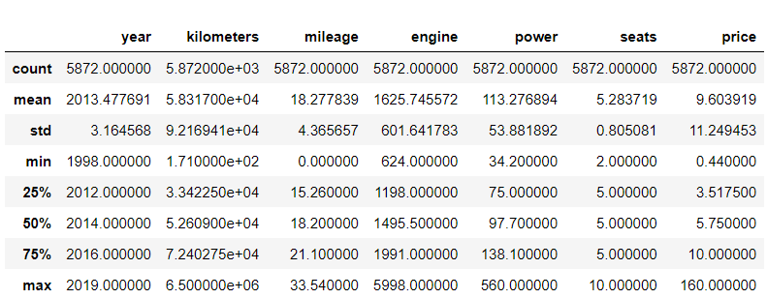
Data Cleaning
Remove unwanted columns
Remove null values
Checked for duplicate rows
Checked summary of the data
Split the Brand and Model name
Alter the needed columns' datatypes
Remove kmpl and km\kg from the mileage column
Remove CC from the engine column
Remove BHP from the power column
SUMMARY OF THE NUMERICAL FEATURES

Slide 8
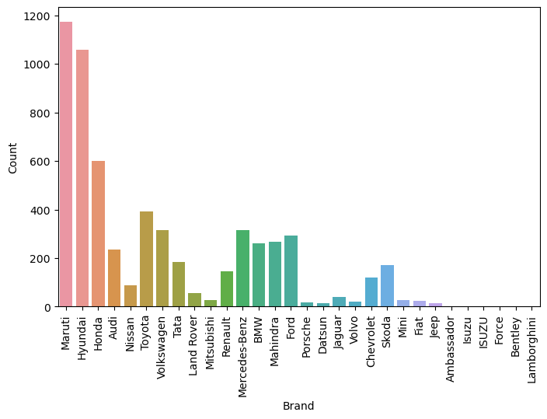
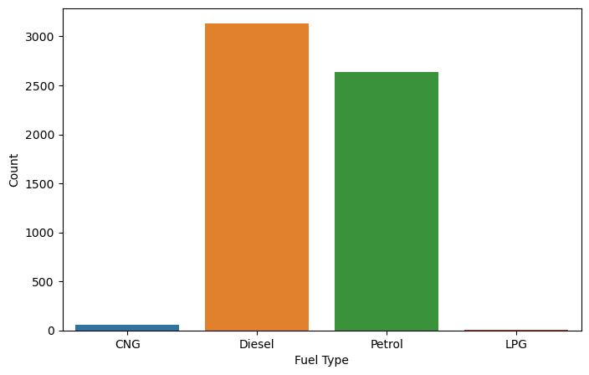
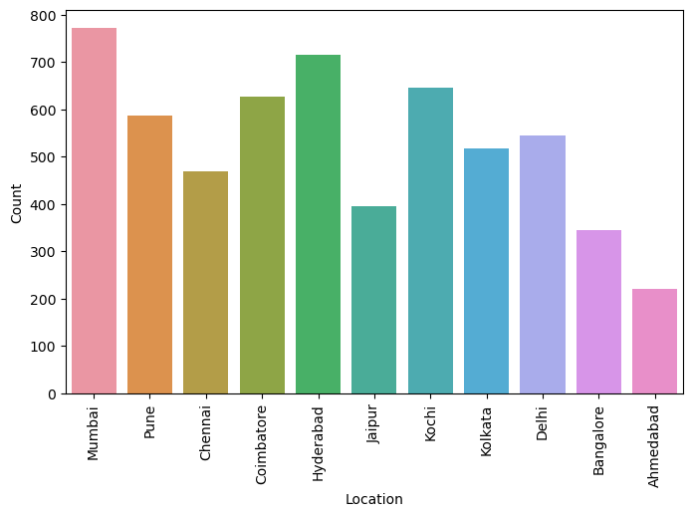
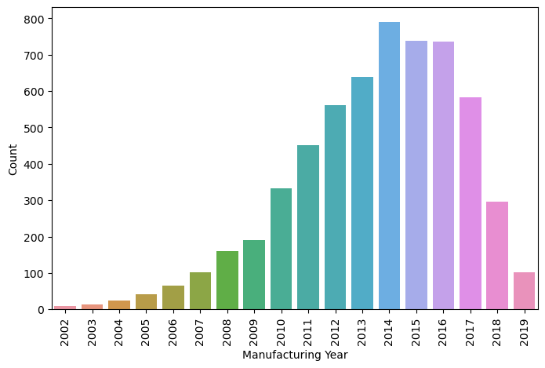
Exploratory Data Analysis: UNIVARIATE
Analysis:
In the market, used Maruti cars are more popular.
Very few used premium and luxury vehicles are available.
3. The majority of used cars have diesel engines.
Most of the used cars are registered in Mumbai.
The majority of used vehicles are manufactured in the year 2014.

Slide 9
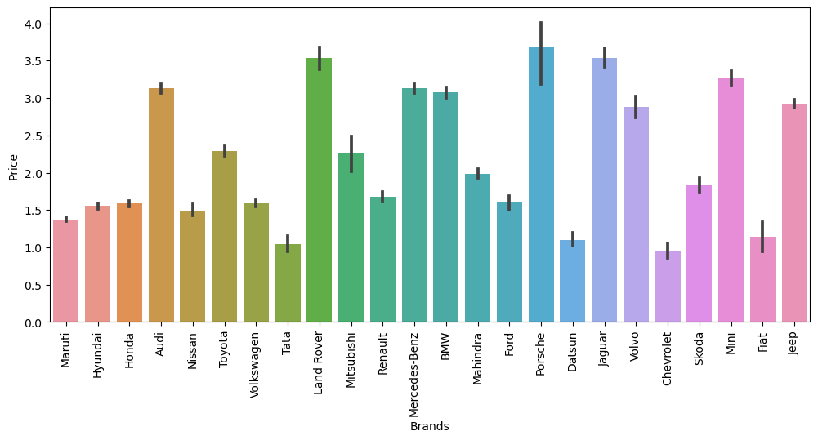
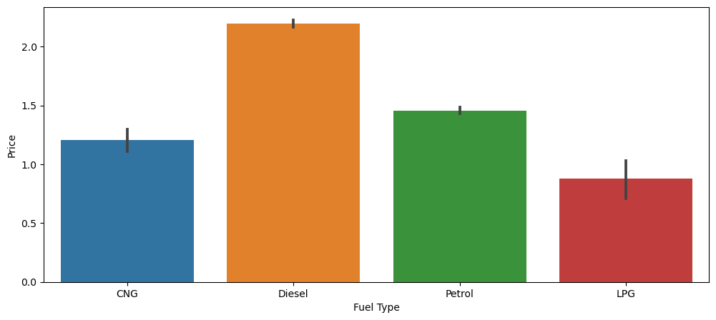
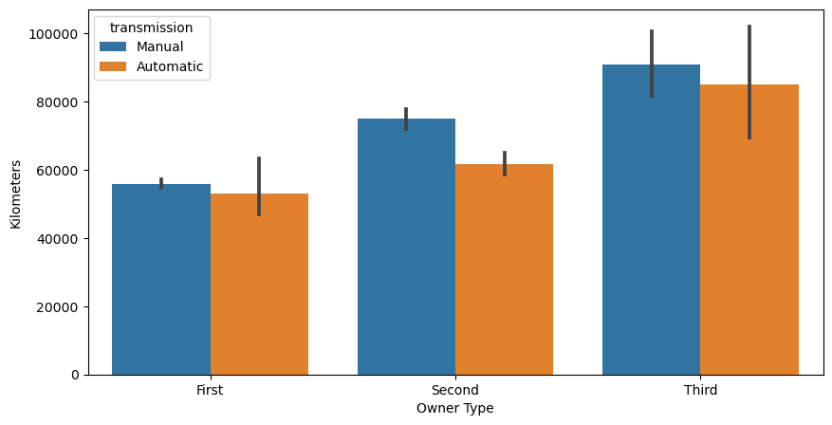
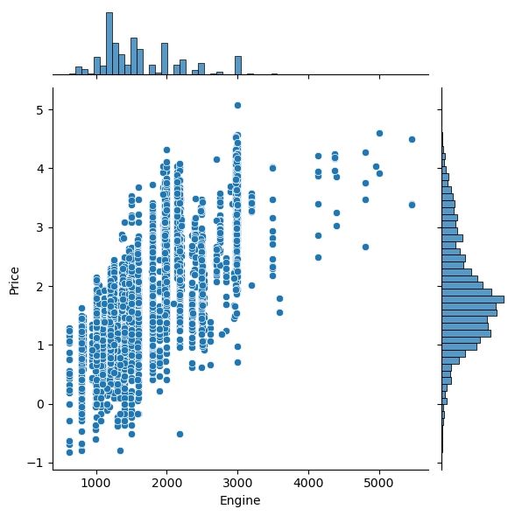
Exploratory Data Analysis: BIVARIATE & Multivariate
Analysis:
The price of used premium and luxurious vehicles is higher.
Diesel-powered used automobiles are more expensive.
The preferred kind of used automobiles have manual transmissions.
The price of a used car rises as the car's engine power increases.
Manual automobiles are more driven in all segments.

Slide 10
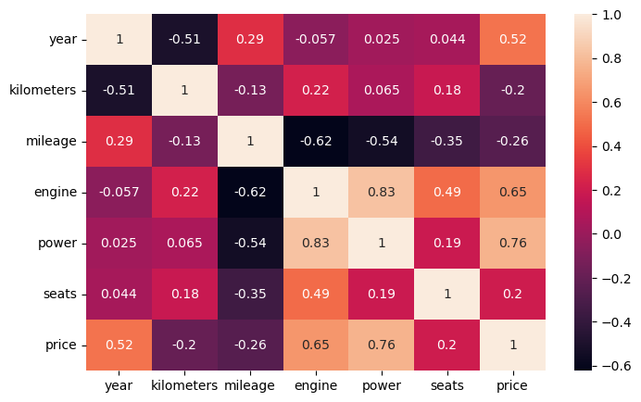
Data Preprocessing
Checked for outliers in the data through IQR
Checked correlation between numerical columns
Created dummies by using one-hot encoder
Scaled the data through Standard Scaler
CORRELATION HEATMAP

Slide 11
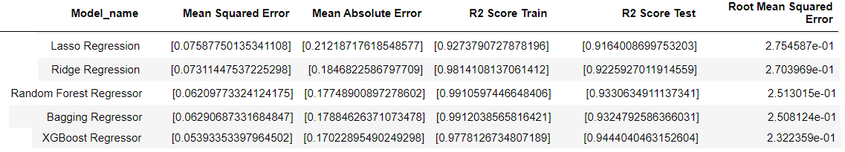
5 best performing Models
LASSO Regression
Ridge Regression
Random Forest Regressor
Bagging Regressor
XGBoost Regressor

Slide 12
Lasso & Ridge Regression Algorithm
Lasso Regression Algorithm:
LASSO stands for Least Absolute Shrinkage and Selection Operator.
It is also known as L1 regularization.
It is a regression algorithm that performs both variable selection and regularization in order to enhance the prediction accuracy.
Mathematical Equation:
Residual Sum of Squares + λ * (Sum of the absolute value of the magnitude of coefficients)
Ridge Regression Algorithm:
It is also known as L2 regularization.
It is a method of estimating the coefficients of multiple-regression models in scenarios where the independent variables are highly correlated.
Mathematical Equation:
Residual Sum of Squares + λ * (Sum of Squares of the magnitude of coefficients)

Slide 13
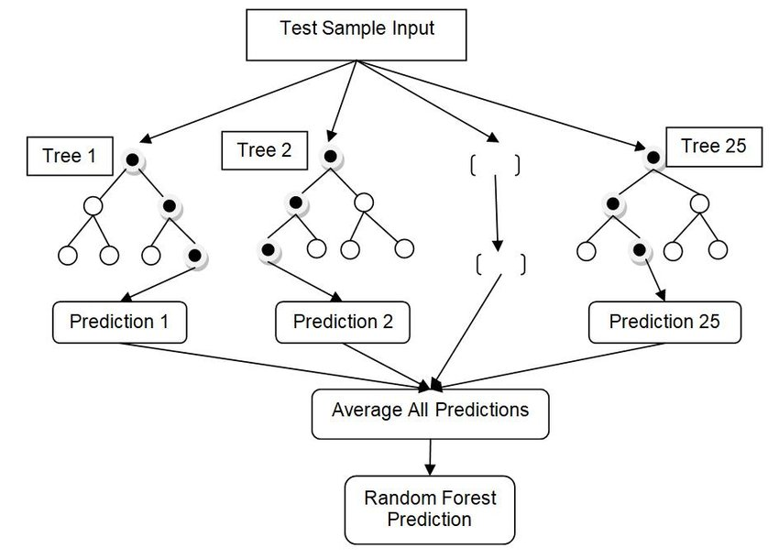
Random Forest
Random Forest is an ensemble technique capable of performing both regression and classification tasks with the use of multiple decision trees and a technique called Bootstrap and Aggregation, commonly known as bagging. The basic idea behind this is to combine multiple decision trees in determining the final output rather than relying on individual decision trees.
Random Forest has multiple decision trees as base learning models. We randomly perform row sampling and feature sampling from the dataset forming sample datasets for every model. This part is called Bootstrap.

Slide 14
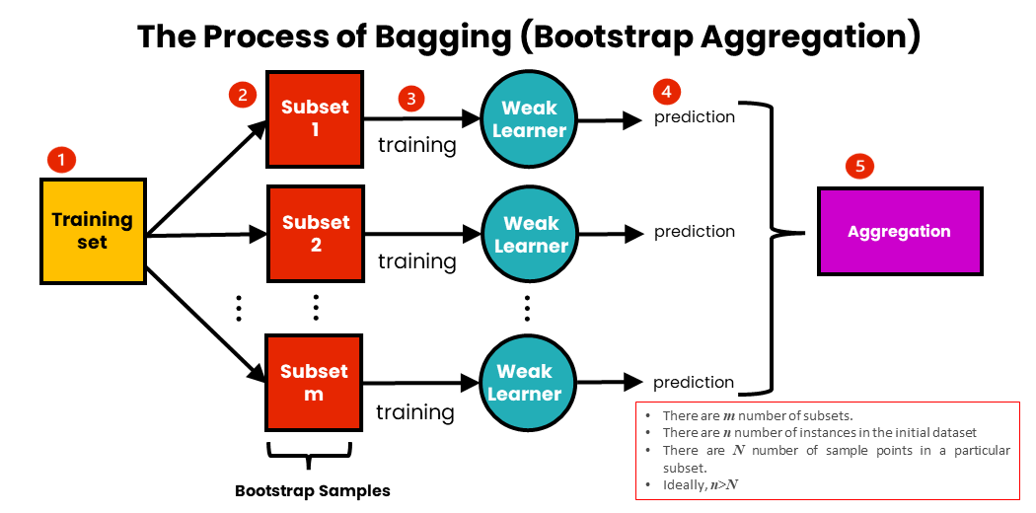
Bagging
Bagging, also known as Bootstrap aggregating.
It is an ensemble learning technique that helps to improve the performance and accuracy of machine learning algorithms.
It is used to deal with bias-variance trade-offs and reduces the variance of a prediction model.
Bagging avoids overfitting of data and is used for both regression and classification models, specifically for decision tree algorithms.
Bootstraping: Bootstrapping is the method of randomly creating samples of data out of a population with replacement to estimate a population parameter.

Slide 15
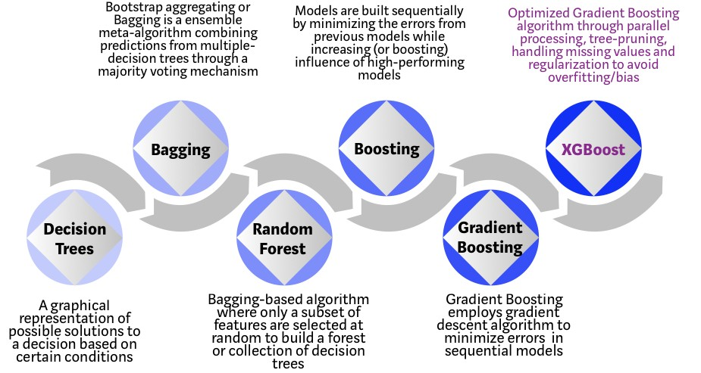
XGBoost
The two main reasons to use XGBoost are:
Execution speed
Model performance

Slide 16
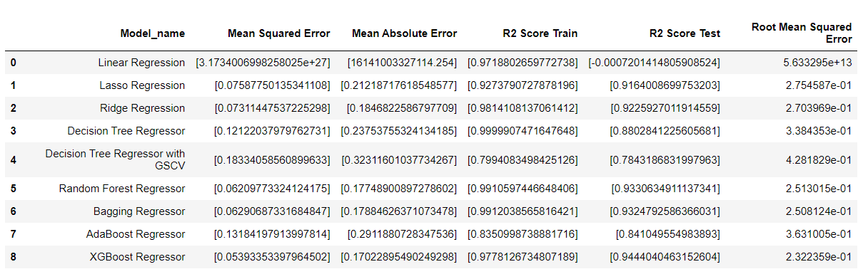
Scorecard

Slide 17
Conclusion
By performing different Machine Learning models, we aim to get a better result or less error with max accuracy. Our purpose was to predict the price of the used cars having 13 predictors and 6019 data entries.
The Analysis has been performed on nine types of machine learning algorithms and out of these nine algorithms XGBoost achieved best accuracy result.”

Slide 18
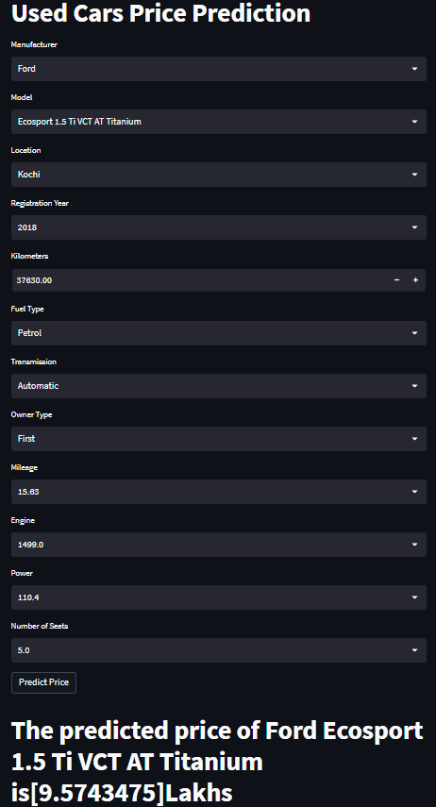
Model Deployment
Raw Data
Predicted Result
Model deployment using Streamlit involves creating a web application that allows users to interact with a trained machine learning model.
Model Deployment

Slide 19


